Slide 1

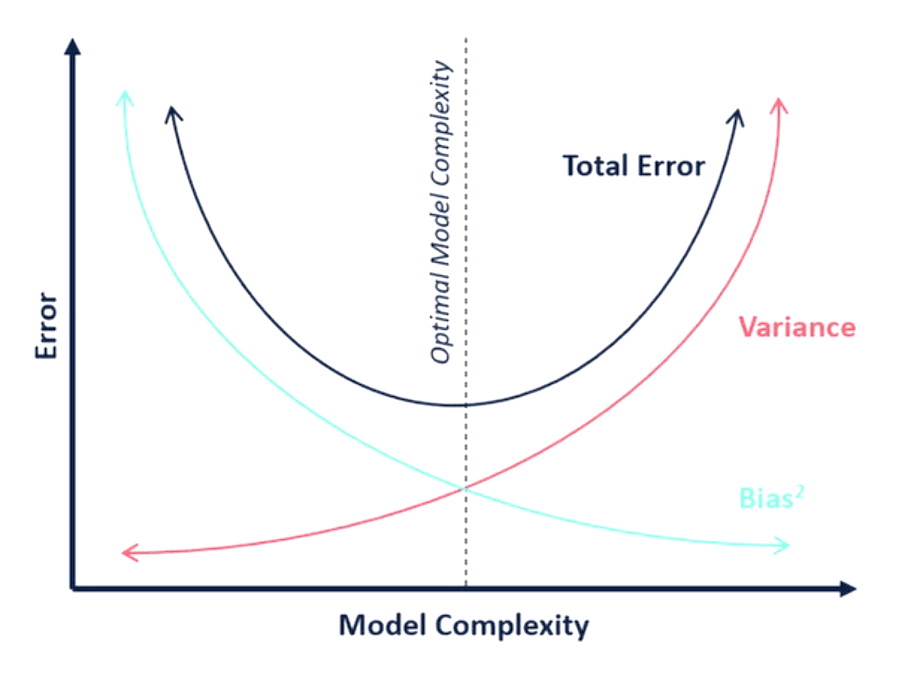
σ²
The Bias-Variance Tradeoff
Navigating the Core Challenge
Understanding how to balance model simplicity and complexity to achieve optimal predictive performance on unseen data.
E[(ŷ-y)²]

Slide 2

Why We Must Master This Concept
1
The Goal of ML
2
The Problem of Error
The fundamental objective in machine learning is to build a model that generalizes well—performing accurately on unseen data, not just the training data.
All models have error. This error can be systematically decomposed into three components: Bias, Variance, and Irreducible Error (noise).
3
The Central Conflict
4
Practical Impact
Bias and Variance are inversely related. Reducing one often increases the other. The tradeoff is the process of finding the sweet spot that minimizes the total error.
Understanding this concept allows practitioners to select the right model complexity, choose appropriate regularization techniques, and build more robust, deployable systems.

Slide 3
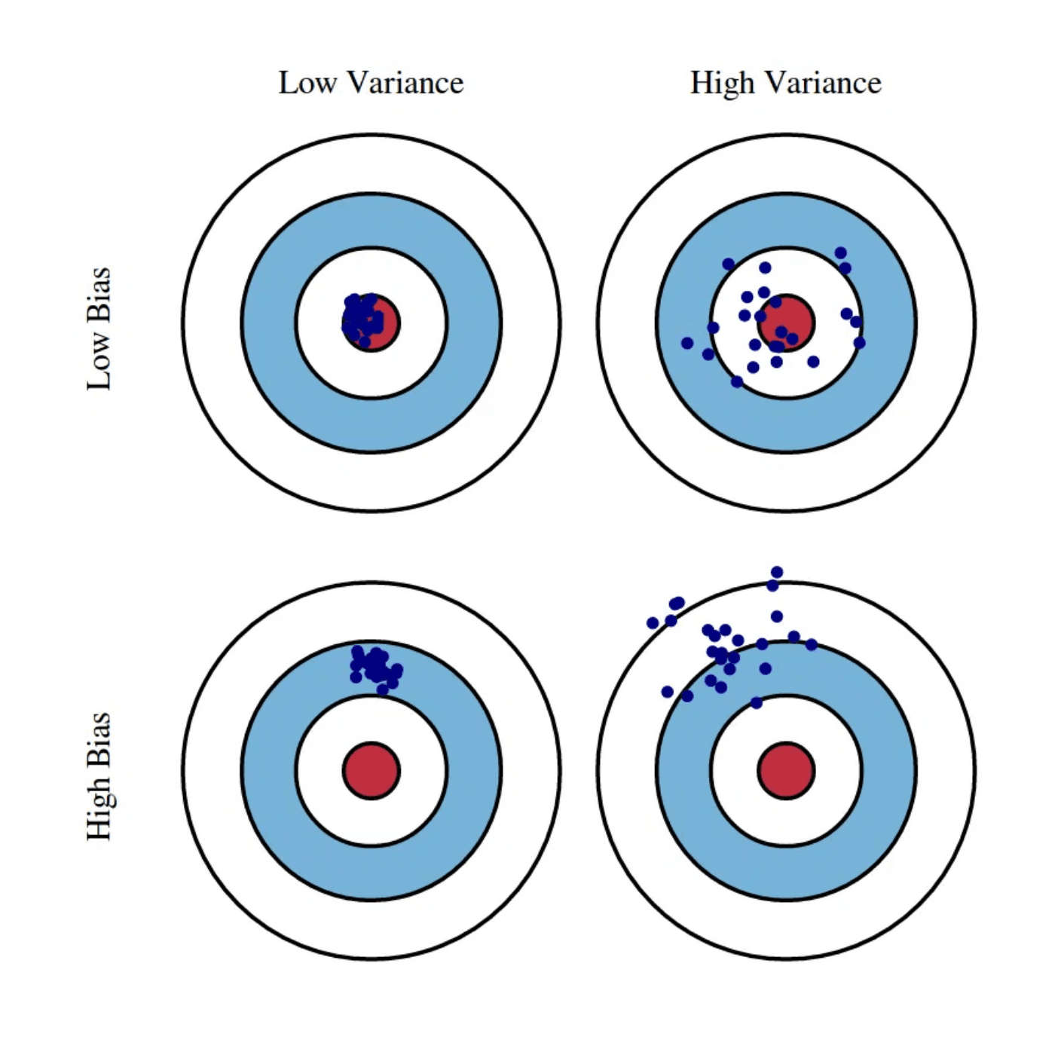
Decomposing Total Error: Bias, Variance, and Noise
Total Error (Expected Loss)
The measure of how far the model's predictions are from the true values. We aim to minimize this metric.
Irreducible Error (Noise)
Error that cannot be reduced by any model, as it is inherent to the data generation process (e.g., measurement errors, random fluctuations).
Bias (Systematic Error)
The error introduced by approximating a real-world problem with a simplified model. It is the difference between the expected prediction and the true value.
Variance (Model Sensitivity)
The error introduced by the model's sensitivity to small fluctuations in the training data. It measures how much predictions change with different training subsets.
E[Total Error] = Bias² + Variance + Irreducible Error

Slide 4
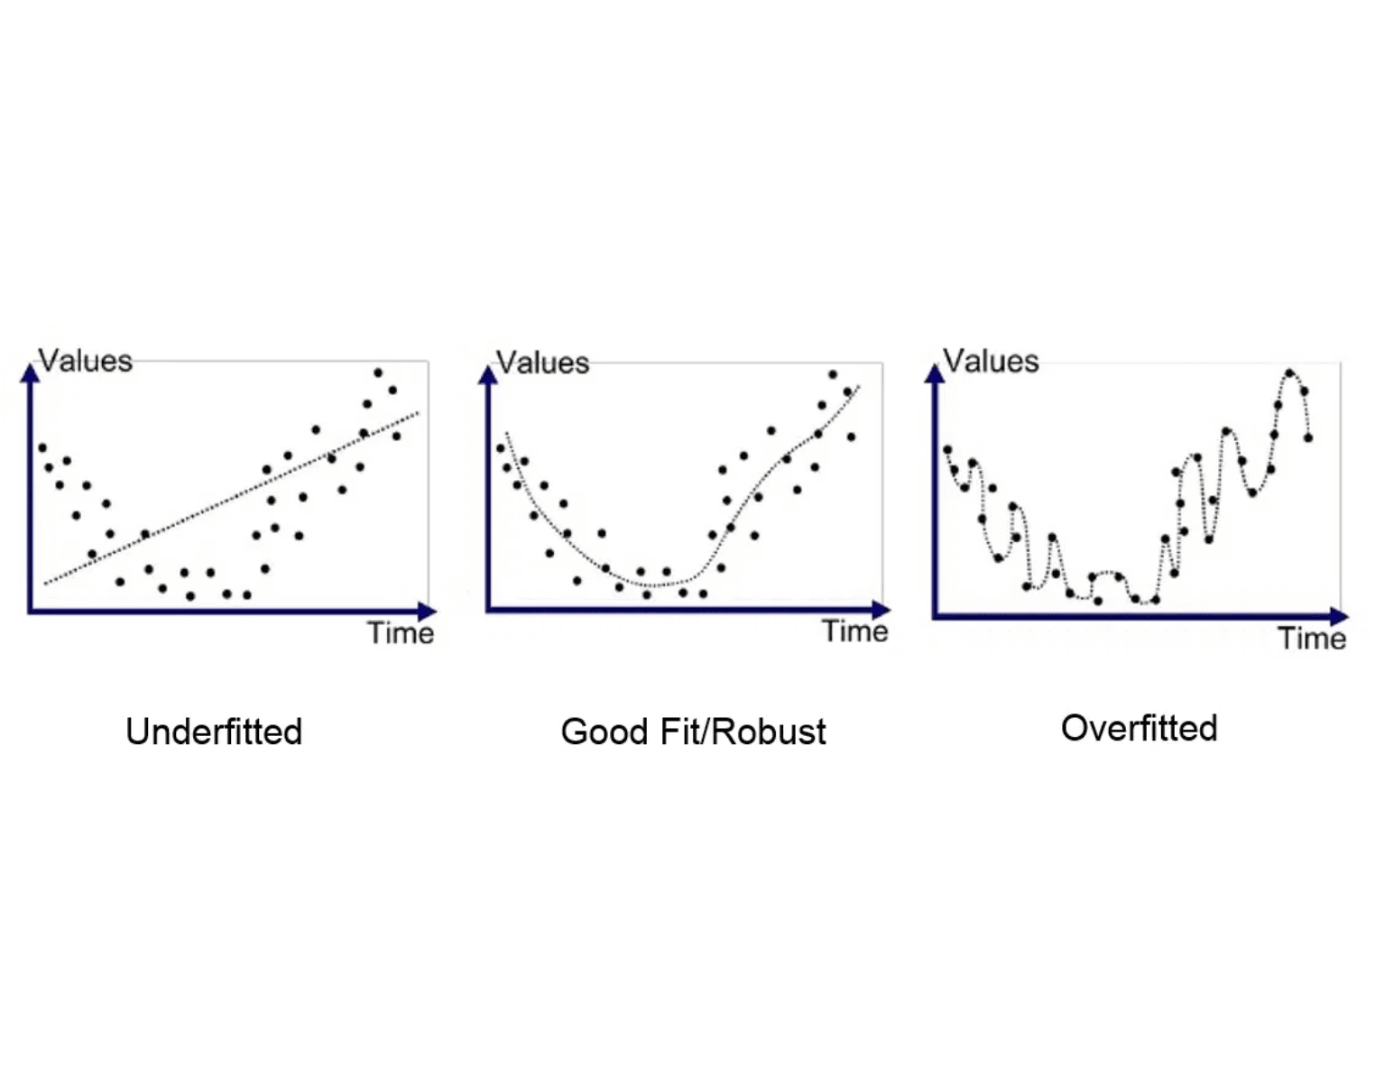
High Bias: The Underfitting Problem
Definition
A model with high bias is too simple or rigid to capture the underlying patterns in the data. It consistently misses the mark.
Symptom: Underfitting
The model performs poorly on both training and test data. It fails to learn the signal because it lacks the complexity to represent the true relationship.
Real-World Example
Trying to fit a straight line (linear model) to data that clearly follows a parabolic curve (non-linear relationship). The line will systematically misrepresent the data.
Learning Analogy
A student who only memorizes definitions but fails to understand concepts. They perform poorly on any test requiring application or critical thinking.

Slide 5
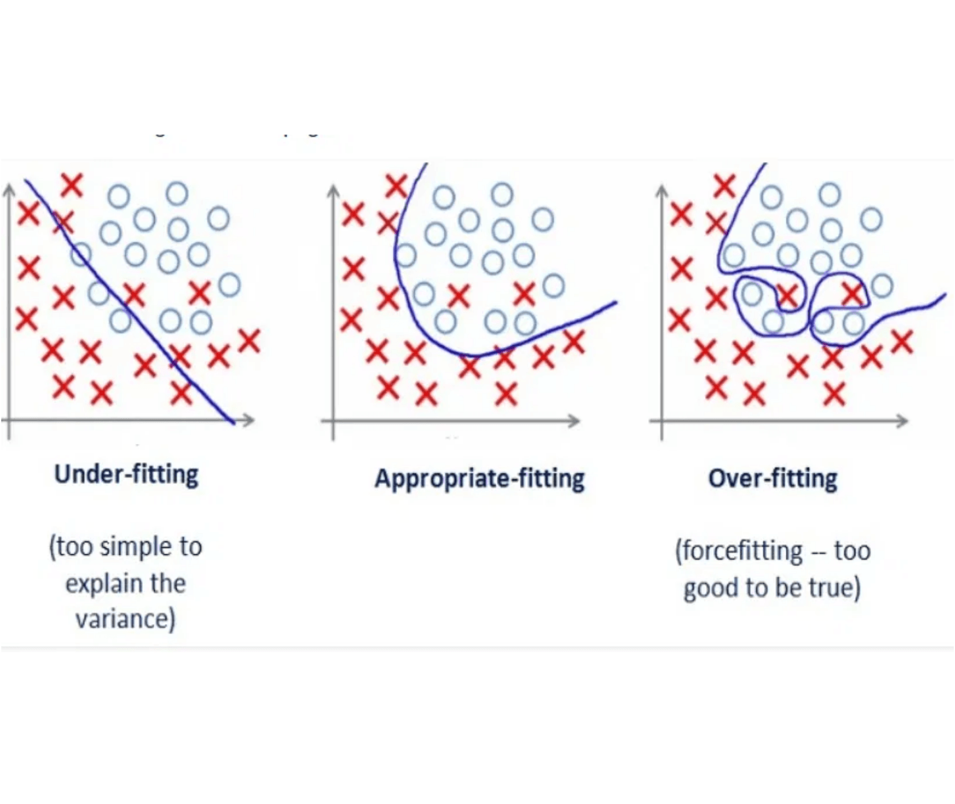
High Variance: The Overfitting Problem
Definition
A model with high variance is too complex or flexible. It doesn't just learn the underlying patterns, it also learns the noise and random fluctuations specific to the training set.
Symptom: Overfitting
The model performs exceptionally well on the training data but performs poorly on test data. It has memorized the training set rather than learning generalizable patterns.
Real-World Example
Fitting a 10th-degree polynomial to a small dataset. The curve will pass through every training point perfectly, but will wildly fluctuate and fail to predict new points accurately.
Learning Analogy
A student who memorizes every question and answer from a practice test. They score perfectly on that specific test but fail a slightly different version of the exam.

Slide 6

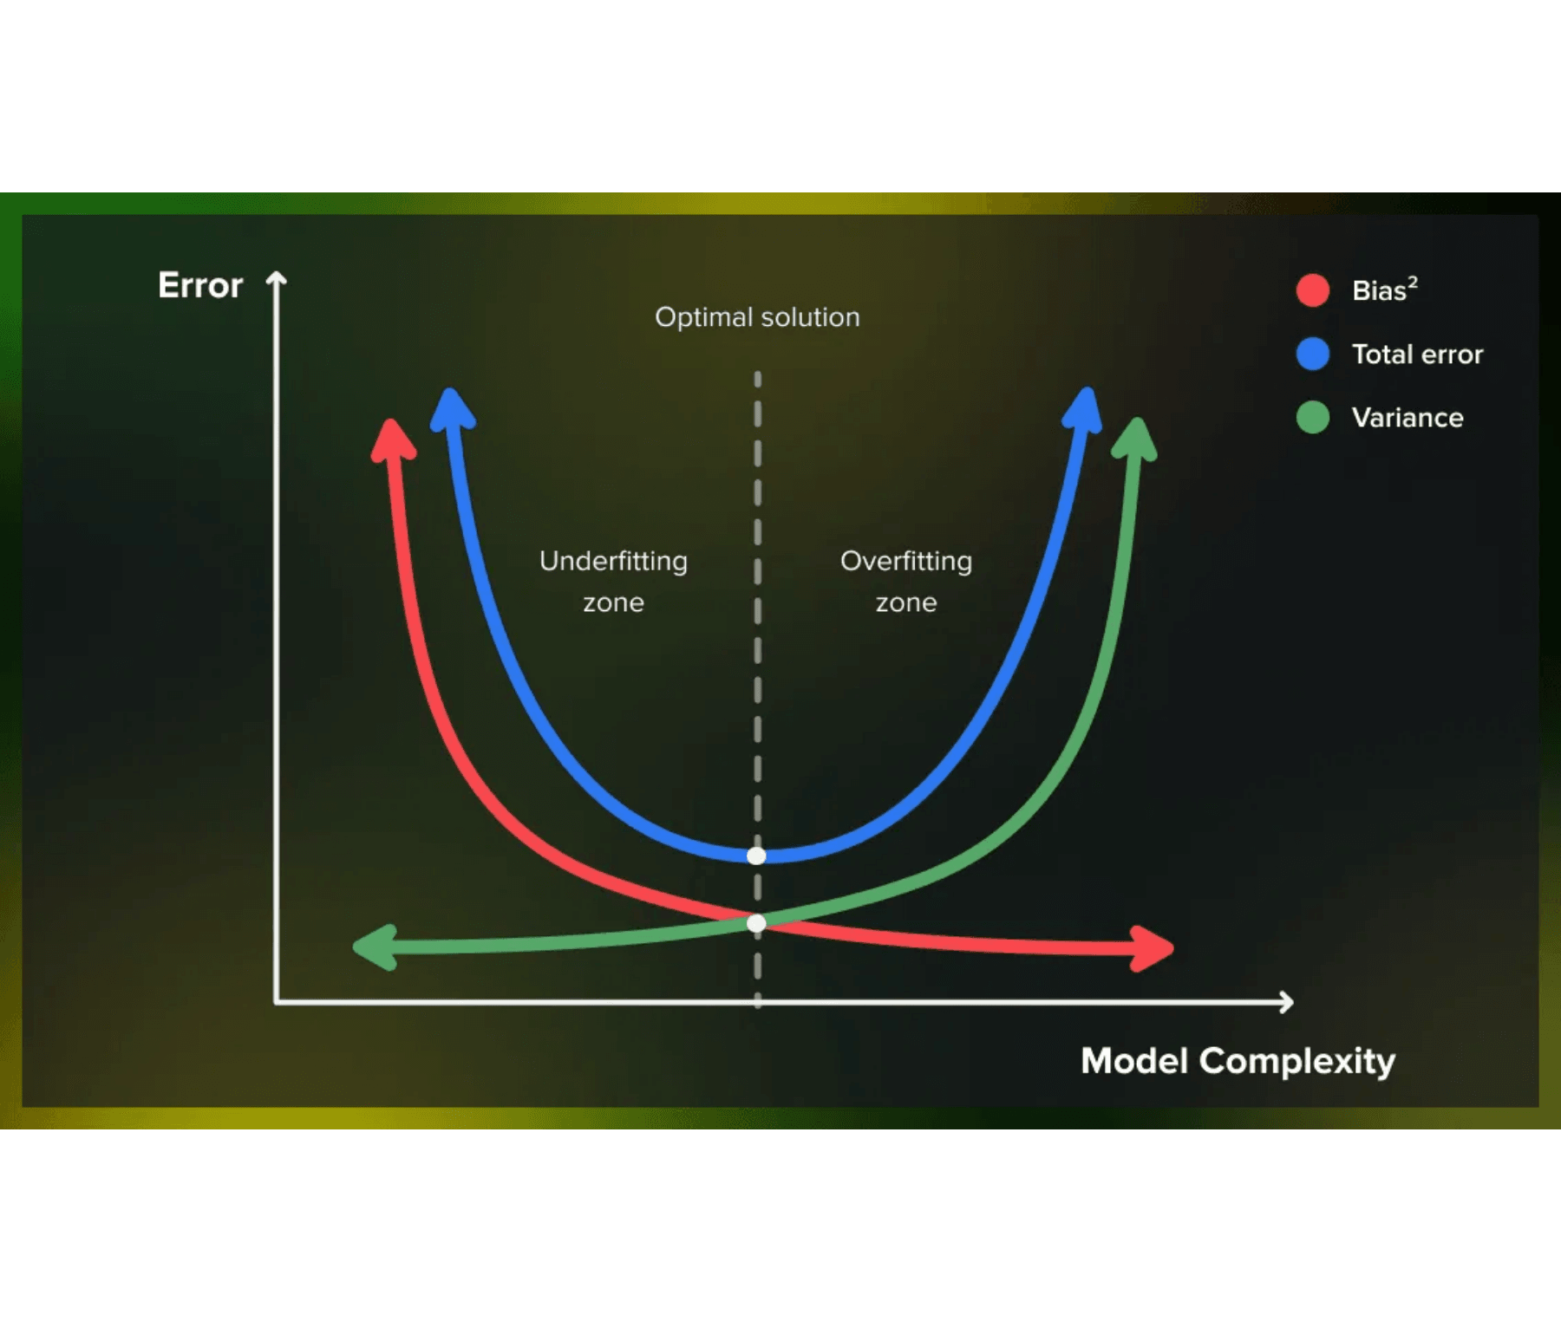
The Tradeoff Curve: Finding the Goldilocks Zone
X-Axis: Model Complexity
Represents the flexibility of the model (e.g., number of features, depth of a tree, degree of a polynomial).
Y-Axis: Prediction Error
Represents the prediction error metric (e.g., Mean Squared Error or classification error).
Bias Curve (Decreasing)
As complexity increases, the model can capture more patterns, so bias decreases.
Variance Curve (Increasing)
As complexity increases, the model becomes more sensitive to noise, so variance increases.
The Goldilocks Zone
The total error curve (sum of Bias and Variance) forms a U-shape. The optimal model complexity is at the bottom of this U, where total error is minimized. This is where we want to be.

Slide 7
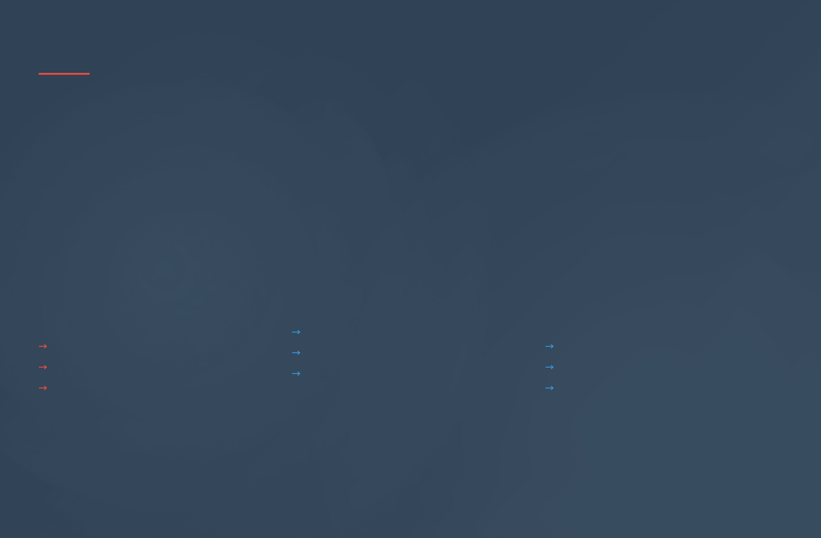
Case Study: Bias-Variance in a Medical Diagnosis Model
The Task
Building a predictive model to diagnose a disease based on patient symptoms and laboratory results. The model must balance sensitivity (catching true cases) with specificity (avoiding false alarms).
High Bias (Underfit)
High Variance (Overfit)
Optimal Balance
Model Type
Model Type
Model Type
Simple rule-based system with only 3 key features
Deep neural network trained on small patient sample
Moderately complex model (e.g., Logistic Regression or Random Forest)
Problem
Problem
Fails to capture complex interactions between symptoms
Memorizes noise specific to training sample
Approach
Result
Captures main relationships without overfitting
Result
False Positives: Many incorrect diagnoses
Result
False Negatives: Misses many true cases
Healthy patients flagged as diseased
Best sensitivity and specificity
Patients with disease go undiagnosed
Clinical consequence: Unnecessary treatment
Reliable predictions on new patients
Clinical consequence: Dangerous
Clinical consequence: Trustworthy
Key Insight
In medical diagnosis, the bias-variance tradeoff is not just an academic exercise—it directly impacts patient outcomes. Finding the optimal balance ensures that the model is neither too conservative (missing real cases) nor too aggressive (creating false alarms).

Slide 8

Tackling High Bias: Making the Model Smarter
Strategies to Reduce Underfitting
1
Increase Model Complexity
2
Add More Relevant Features
Switch to a more flexible model architecture that can capture non-linear patterns and complex relationships.
Introduce new variables that have a strong relationship with the target variable, providing the model with more information.
Example: Replace Linear Regression with Polynomial Regression, or use a deeper Neural Network.
Example: In house price prediction, add features like square footage, neighborhood quality, and age of the house.
3
Reduce Regularization
4
Feature Engineering
Decrease the penalty on model complexity (e.g., lower the λ value in Ridge or Lasso regression), allowing the model to fit the data more closely.
Transform existing features to better represent the underlying relationship between inputs and outputs.
Example: Create interaction terms (e.g., age × income), polynomial features, or log transformations.
Example: Reduce the L2 regularization coefficient to allow larger weights and more complex decision boundaries.
⚠ Key Insight
When diagnosing high bias, look for poor performance on both training and test data. This is your signal that the model is too simple and needs to be made more flexible.

Slide 9

Tackling High Variance: Making the Model More Robust
Strategies to Reduce Overfitting
1
Get More Training Data
2
Reduce Model Complexity
The most effective solution. More data dilutes the impact of noise and forces the model to learn the true signal rather than memorize specific examples.
Simplify the model architecture to reduce its capacity to fit noise. This includes using fewer features, pruning decision trees, or using shallower neural networks.
Example: Collecting more patient records for a medical diagnosis model makes it harder for the model to memorize individual cases.
Example: Replace a 10th-degree polynomial with a 2nd-degree polynomial, or reduce the number of layers in a neural network.
3
Increase Regularization
4
Ensemble Methods
Add a penalty term to the loss function (e.g., L1 or L2 regularization) to constrain the model's weights, which discourages overly complex solutions.
Combine multiple high-variance models to create a single, more stable, low-variance model. Techniques like Bagging and Boosting average out individual model noise.
Example: Increase the λ (lambda) value in Ridge or Lasso regression to penalize large weights and prevent overfitting.
Example: Use Random Forests (ensemble of decision trees) instead of a single deep decision tree to reduce variance.
⚠ Key Insight
When diagnosing high variance, look for large gap between training and test performance. The model performs well on training data but poorly on new data—this is your signal that it's memorizing rather than generalizing.

Slide 10

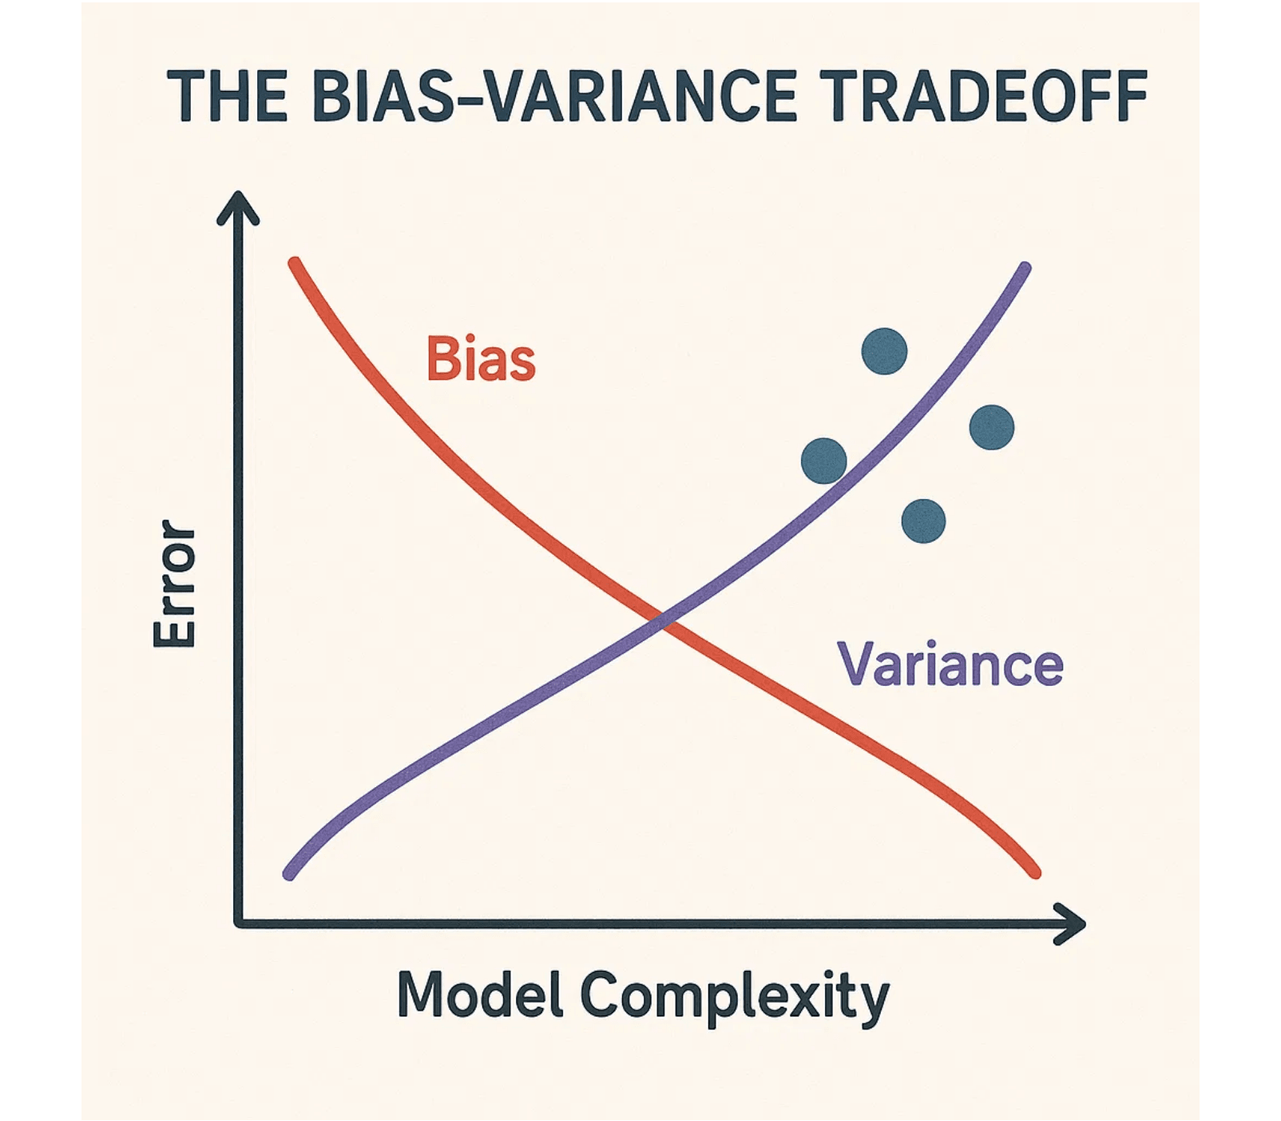
Conclusion: The Art of the Tradeoff
The Tradeoff is Inevitable
Bias and Variance are two sides of the same coin. Managing them is the core challenge of model tuning and optimization.
The Goal is Generalization
We don't seek to minimize training error (which leads to high variance), but to minimize the test error on unseen data.
Use Diagnostic Tools
Employ Learning Curves and Cross-Validation to diagnose whether your model suffers from high bias or high variance.
Continuous Refinement
Finding the optimal balance is an iterative process involving model selection, feature engineering, and hyperparameter tuning.
Remember
The bias-variance tradeoff is not a problem to be solved, but a fundamental principle to be understood and managed. Master this concept, and you master the art of building machine learning models that truly generalize.

Slide 11

Questions and Further Learning
Discussion Questions
How would you diagnose whether your model is suffering from high bias or high variance?
?
Why is getting more training data often the most effective solution for high variance?
?
Can you think of a real-world problem where the bias-variance tradeoff is particularly critical?
?
What role does cross-validation play in identifying the optimal model complexity?
?
Key Resources for Deeper Learning
Foundational Books
Online Courses & Tutorials
→
The Elements of Statistical Learning
→
Andrew Ng's Machine Learning Specialization
Hastie, Tibshirani, and Friedman - The definitive reference on statistical learning theory and practice.
Practical, intuitive introduction to ML concepts including bias-variance tradeoff.
→
Fast.ai Practical Deep Learning
→
Pattern Recognition and Machine Learning
Top-down approach to understanding deep learning and model regularization techniques.
Christopher Bishop - Comprehensive coverage of ML fundamentals with mathematical depth.
Academic Papers
Practical Tools & Libraries
→
Geman, Bienenstock & Doursat (1992)
→
scikit-learn Learning Curves
"Neural Networks and the Bias/Variance Dilemma" - Seminal paper on the bias-variance decomposition.
Python library with built-in functions to visualize bias-variance tradeoff empirically.
→
TensorFlow & PyTorch
→
Domingos (2000)
Deep learning frameworks with regularization and hyperparameter tuning capabilities.
"A Unified Bias-Variance Decomposition" - Theoretical framework for understanding the tradeoff.
Keep Learning and Experimenting
The bias-variance tradeoff is not just theory—it's a practical skill that improves with experience. Build models, analyze their performance, and iterate. Use learning curves and cross-validation to diagnose problems. The more you practice, the better your intuition will become for finding the optimal balance.

Slide 12
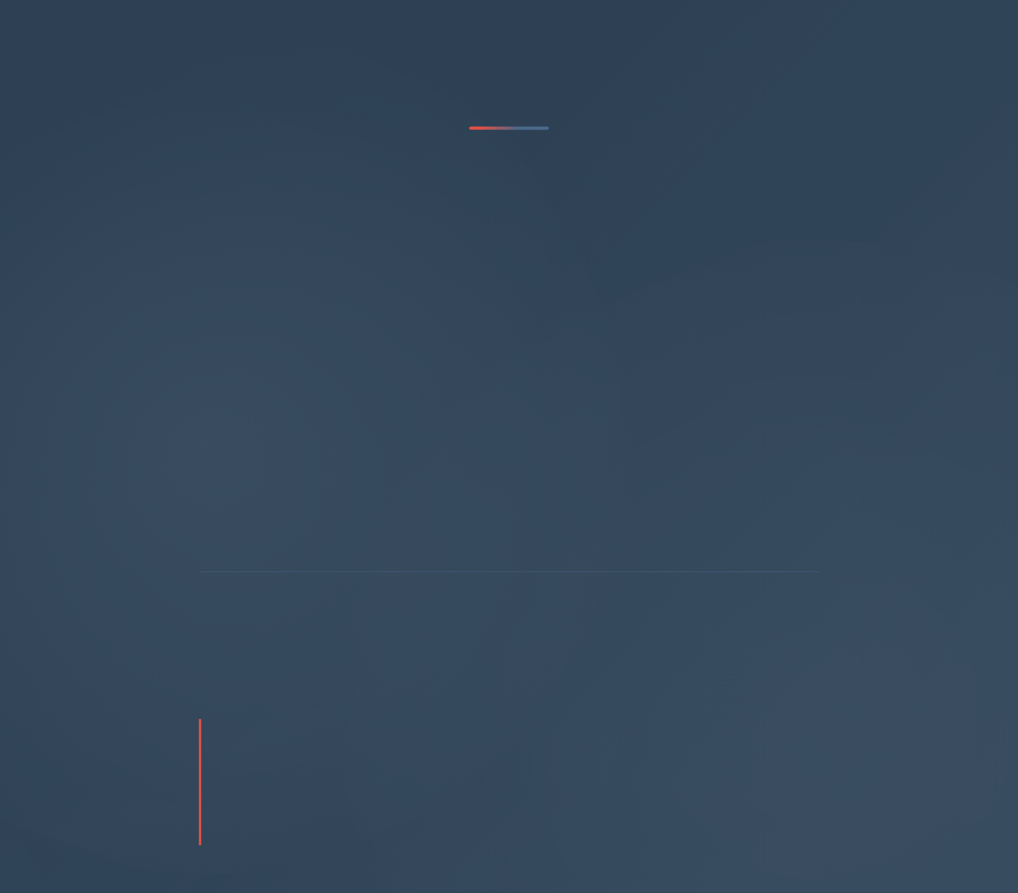
Thank You!
You now understand one of the most fundamental concepts in machine learning: the bias-variance tradeoff.
This knowledge will guide every model you build, every hyperparameter you tune, and every decision you make in your machine learning journey.
Remember
The goal is not to minimize training error, but to minimize test error. Always ask yourself: Is my model too simple? Or is it too complex? The answer lies in understanding the bias-variance tradeoff.
Next Steps
Apply these concepts to real datasets. Experiment with different model complexities. Use learning curves and cross-validation to diagnose your models. Keep learning, keep experimenting, and keep improving.
"In machine learning, wisdom is knowing when to say 'enough is enough.' The bias-variance tradeoff teaches us that balance is not weakness—it is the path to robust, generalizable models."
— The Art of Model Building

